Slide 1
DAY 4
STYLE AND NARRATIVE

Slide 2
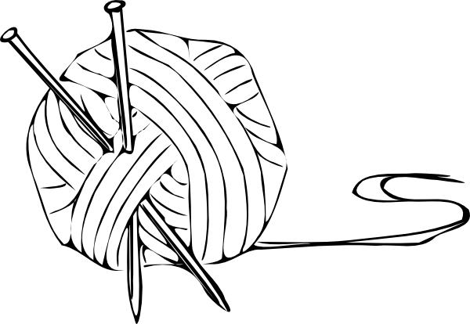
DEMONSTRATION:
Bergson’s Theory of
Duration
Linear and Constant
Continuous flow of aging
Growth of memory
Darl shows this!

Slide 3
YOUR TURN!
Table A: Page 81 – Translate the passage
→ In a strange room…And so if I am not emptied yet, I am is.
Table B: Page 101 – Translate the passage
→ But my mother is a fish…Are is too many for one woman to foal.
Table C: Page 121 – Interpret Dewey Dell’s Dream about Darl & italic’s function
→ He’ll do as I say…I killed Darl.
Table D: Page 146 – What does the ‘looping string’ mean?
→ It is as though the space between us…not the interval between.

Slide 4
DARL
CHAPTER 17 (pg 81) – DARL’S NARRATION
In a strange room you must empty yourself for sleep. And before you are emptied for sleep, what are you. And when you are emptied for sleep, you are not. And when you are filled with sleep, you never were. I don’t know what I am. I don’t know if I am or not. Jewel knows he is, because he does not know that he does not know whether he is or not. He cannot empty himself for sleep because he is not what he is and he is what he is not…and since sleep is is-not and rain and wind are was, it is not. Yet the wagon is, because when the wagon is was, Addie Bundren will not be. And Jewel is, so Addie Bundren must be. And then I must be, or I could not empty myself for sleep in a strange room. And so if I am not emptied yet, I am is.

Slide 5
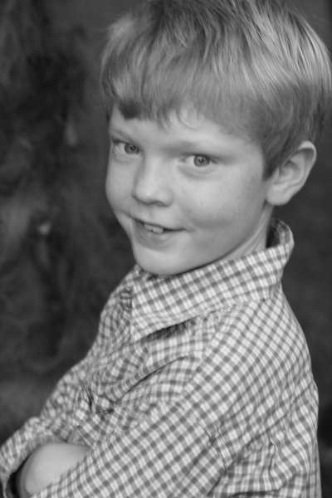
VARDAMAN
CHAPTER 24 (pg 101) – VARDAMAN’S NARRATION
But my mother is a fish. Vernon seen it. He was there.
“Jewel’s mother is a horse,” Darl said.
“Then mine can be a fish, cant it, Darl?” I said.
Jewel is my brother.
“Then mine will have to be a horse, too,” I said.
“Why?” Darl said. “If pa is your pa, why does your ma have to be a horse just because Jewel’s is?”
“Why does it?” I said. “Why does it, Darl?”
Darl is my brother.
“Then what is your ma, Darl?” I said.
“I haven’t got ere one,” Darl said. “Because if I had one, it is was. And if it is was, it cant be is. Can it?”

Slide 6
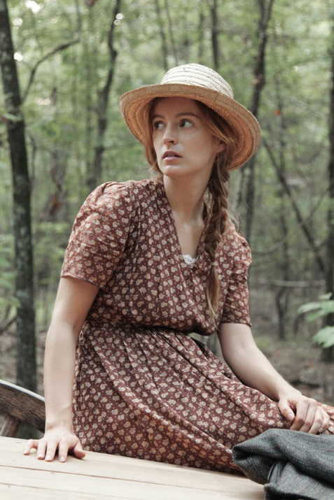
DEWEY DELL
CHAPTER 30 (pg 121) – Dewey Dell’s Narration
He'll do as I say . He always does. I can persuade him to do anything. You know i can. Suppose I say turn here. That was when I died at the time. Suppose I do. We'll go to New Hope. We wont have to go to town. I rose and took the knife from the streaming fish still hissing and I killed Darl.

Slide 7
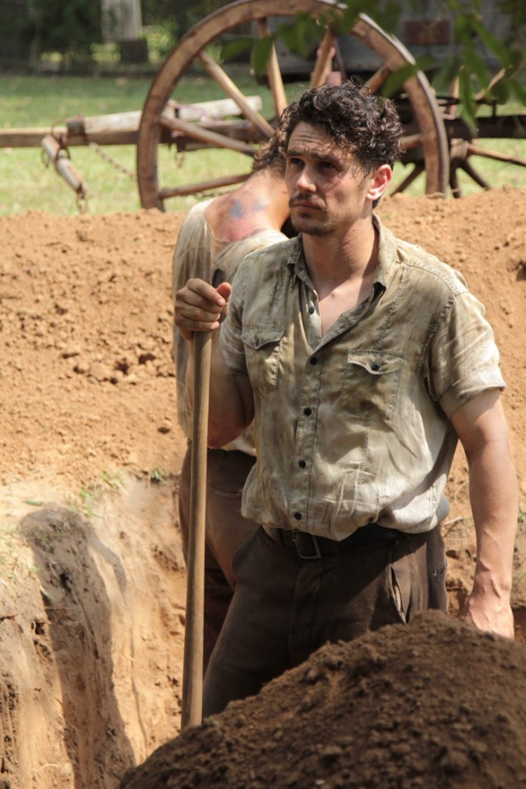
CHAPTER 34 (pg 146) – Darl’s Narration
It is as though the space between us were time: an irrevocable quality. It is as though time, no longer running straight before us like a looping string, the distance being the doubling accretion of the thread and not the interval between.

Slide 8
NARRATIVE ASPECT
Darl, Addie
Jewel, Cash

Slide 9
DARL’S NARRATIVE
Tells what he sees, hears, does…never what he thinks or feels
Reliable narrator but omniscient ability
Present and past tense forms
Loss of existence – no place in time → constant changes in tenses
Uncertainty of the truth
Unable to cope with Addie’s death (Southern Literary Journal)

Slide 10
ADDIE’S NARRATIVE
Bringing us back in time (Dorrit Cohn)
Autobiographical monologue – “lone speaker”

Slide 11
JEWEL’S NARRATIVE
(Southeast Missouri State University – Robert Hamblin)
“One Lick Less” vs “Chuck. Chuck. Chuck”
Jewel’s ‘One Lick Less” : Coffin completion means LESS time Addie has to live
Time will dissipate the effect of Addie’s death
Darl’s adze (axe) sound comforts him, knowing Addie is still alive

Slide 12
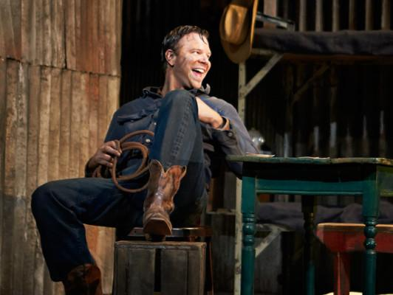
CASH’S NARRATIVE
Chapter 18: Cash’s first narrative
Faulkner introduces Cash after he finished coffin
Started in past tense
Reviewing his completion of coffin to satisfy himself
Addie can no longer assure him that she is satisfied

Slide 13
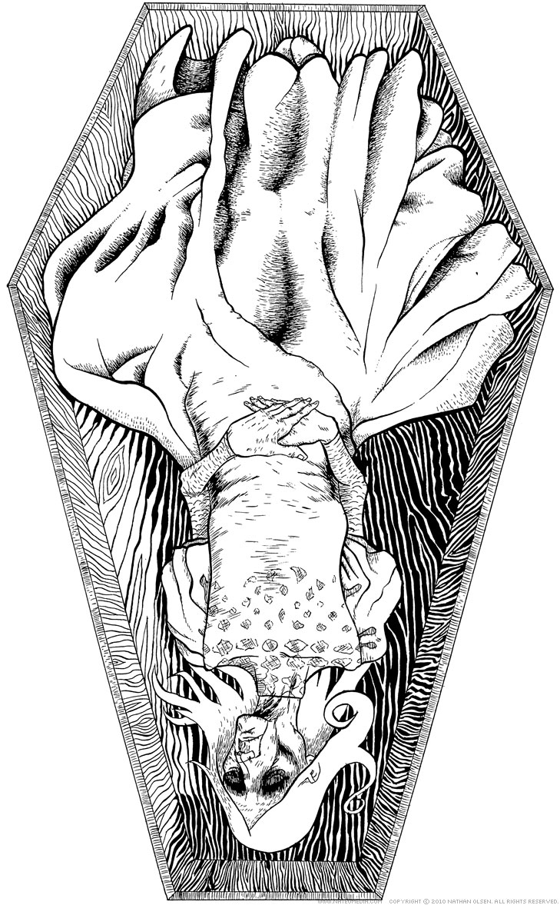
Questions about
Narrative Style!

Slide 14
Question 1:
Why does Faulkner use interior monologue (stream of consciousness) in his narration? What effect does this have?

Slide 15
Question 2 :
What is the significance of chapters 39,40, and 41? Think about narration and who is narrating.

Slide 16
Question 3:
Why would Faulkner change the past and present in the novel? Consider Vernon.

Slide 17
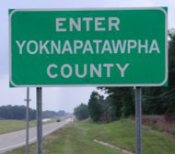
Minor Characters
Why would Faulkner have minor characters narrate? What purpose does this serve? Consider Samson, Macgowen, Mosely, and Armstid.

Slide 18
Colloquial Story Telling
Samson: (Chapter 29, page 114)
“I notice how it takes a lazy man, a man that hates moving, to get set on moving once he does get started off”
“A woman that’s been dead in a box four days, the best way to respect her is to get her into the ground as quick as you can”
Armstid: (Chapter 43, page 114)
“A man’ll always help a fellow in a tight, if he’s get ere a drop of Christian blood in him”
McGowan: (Chapter 55, page 246)
“How bad do you want to do something?” I says. She looks at me. “Of course, a doctor learns all sorts of things folks dont think he knows. But he aint supposed to tell all he knows. It’s against the law.”
“Where do I take it?” She says.
“Down in the cellar,” I says.

Slide 19
Figurative
Language
Metaphors, Diction,
Syntax

Slide 20
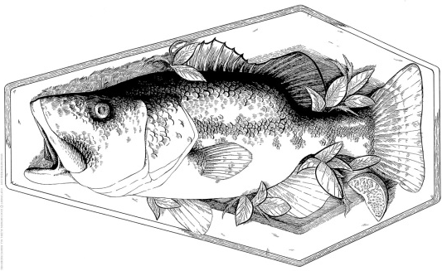
METAPHOR
Chapter 44 – Page 196 – Vardaman’s Narration
Jewel’s mother is a horse. My mother is a fish. Darl says that when we come to the water again I might see her and Dewey Dell said, She’s in the box; how could she have got out? She got out through the holes I bored, into the water I said, and when we come to the water again I am going to see her. My mother is not in the box. My mother is a fish

Slide 21
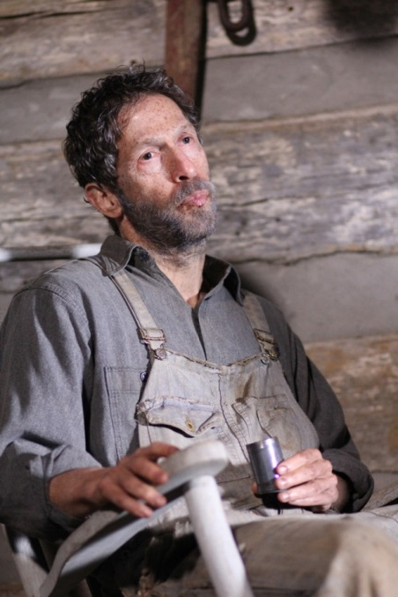
Irony
Chapter 52 – Page 228 – Darl’s Narration
"Who the hell can’t dig a damn hole in the ground?" Jewel says.
"It ain’t respectful, talking that way about her grave," Pa says. "You all don’t know what it is. You never pure loved her, none of you." Jewel does not answer. He sits a little stiffly erect, his body arched away from his shirt.

Slide 22
Debate Time!
What is more essential to the novel: narration or figurative language ( remember figurative language includes allusions, stylistic devices like the italics, ect.)
Table A and B: support figurative language
Table C and D: support narration

